Slide 1
The 36th New England Statistics Symposium
Statistical Models for Neural Spiking Data
Uri Eden
Department of Mathematics and Statistics
Boston University
June 3, 2023

Slide 2
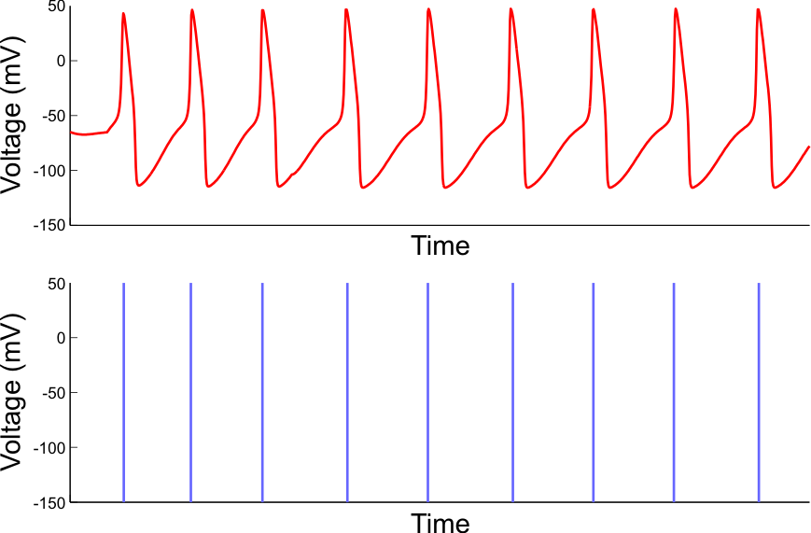
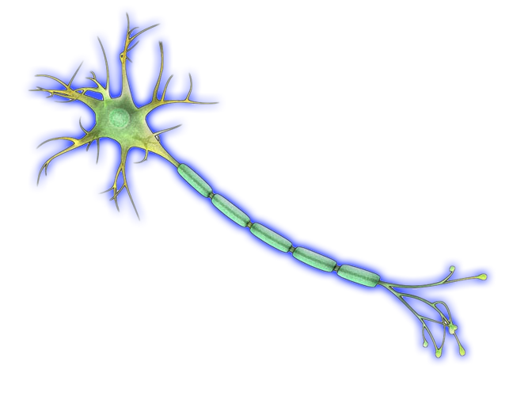
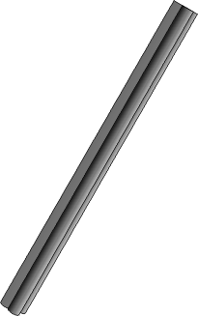
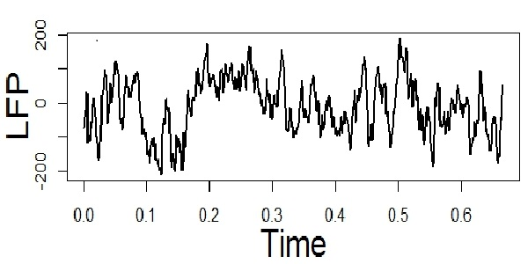
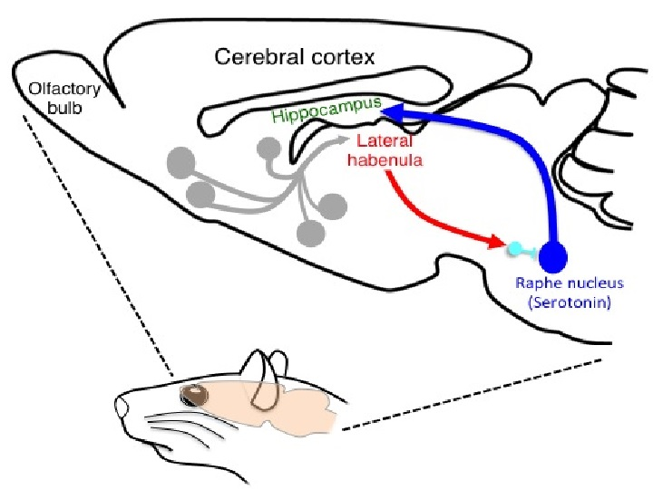
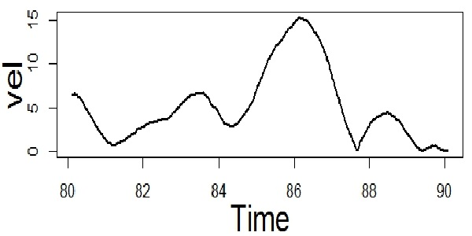
Neuroscience experiments require integrating information from multiple sources
Neurons communicate via stereotyped electrical impulses, called “spikes”.
${10}^{4}\sim {10}^{5}$ neurons

Slide 3
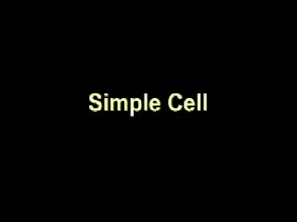
A classic neuroscience experiment

Slide 4
Features of some classical experiments
Recorded activity from an isolated neuron in a single brain area
Simple stimulus/response paradigm
All signals are directly observable
Neural representation clear to the naked eye

Slide 5
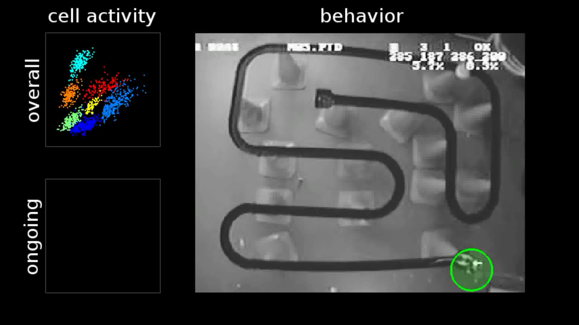
A more recent neuroscience experiment

Slide 6
Evolution of experimental and analytic approaches
Increasing stimulus complexity
From simple and experimenter controlled to naturalistic and uncontrolled
From single-variate to high dimensional
Increasing response complexity
Single cell responses to coordination of populations within and across multiple brain areas
Single response modality to multimodal signals
Increasing association complexity
Stationary models to ones that explicitly capture dynamic representations
Directly observable vs hidden dynamics

Slide 7
OUTLINE
Point process models for individual neurons
Multivariate point process models for sorted neurons
Estimating network structure
Marked point process modeling
State space decoding models
MATLAB decoding example
Conclusions

Slide 8
Stochastic Neural Modeling
Input:
Output:
Neural
X :
Spiking
N :
M :
System
θ : Model Parameters
Point Process System Model:
Recursive System Model:

Slide 9
The Conditional Intensity Function
Unified mathematical construct to model any neural spiking process
Generalizes Poisson rate function
Provides building blocks for data likelihood and posterior distributions

Slide 10
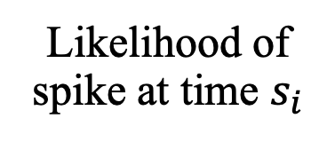
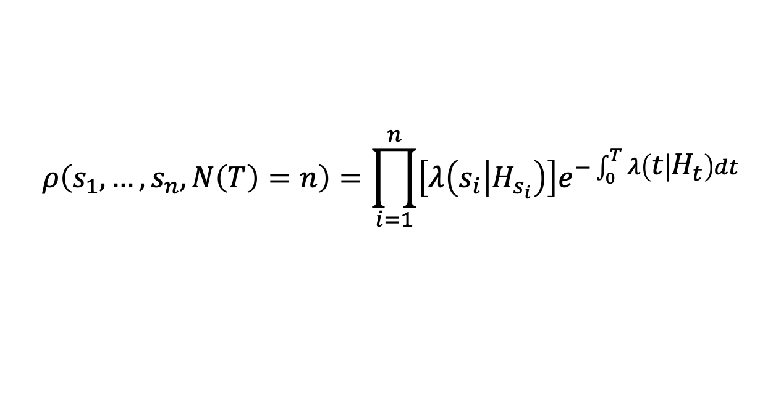
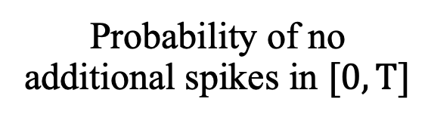
Point process likelihood
Likelihood of any spike sequence
$$ρ\left(s_{1},…,s_{n},N\left(T\right)=n\right)=\prod_{i=1}^{n}{\left[λ\left(s_{i} | H_{s_{i}}\right)\right]e^{−\int_{0}^{T}{λ\left(t | H_{t}\right)dt}}}$$
Likelihood of spike at time $s_{i}$
Probability of no additional spikes in $[0,T]$

Slide 11
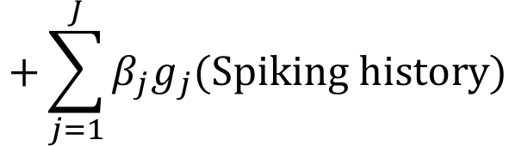
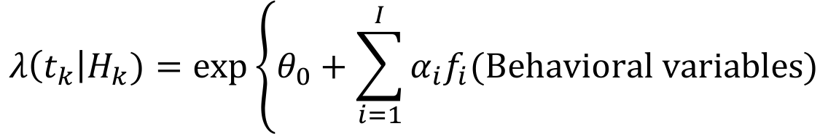
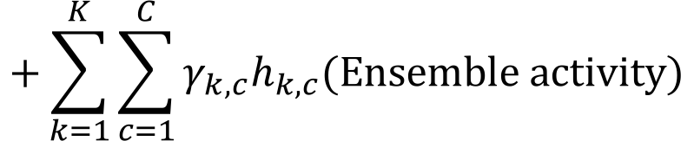
Generalized Linear Spiking Models
$$λ\left(t_{k}\right|H_{k})=\exp\left\{θ_{0}+\sum_{i=1}^{I}{α_{i}f_{i}(\text{Behavioral} \text{variables}\text{)}}\right.$$
$$+\sum_{j=1}^{J}{β_{j}g_{j}(\text{Spiking} \text{history}\text{)}}$$
$$+\sum_{k=1}^{K}{\sum_{c=1}^{C}{γ_{k,c}h_{k,c}(\text{Ensemble} \text{activity}\text{)}}}$$
By selecting appropriate sets of basis functions we can capture arbitrary functional relations.
Find parameters that maximize likelihood of observed spiking.
Truccolo W, Eden UT, Fellows MR, Donoghue JP, Brown EN. (2004) J. Neurophys 93:1074-1089

Slide 12
Multivariate point process models for sorted neurons
When
1) neural identities of spikes are known with certainty, and
2) neurons do not fire exactly simultaneously or with precise temporal spacing,
Then the joint distribution of the population spiking can be modeled by fitting separate models for each neuron as a function of the history of the full ensemble.

Slide 13
Spike Sorting

Slide 14
Multivariate Point Process Model
Neuron 1
?
Biological Signal
Neuron 2
…
Neuron C

Slide 15
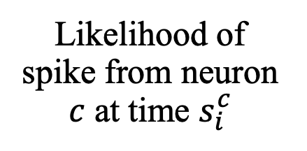
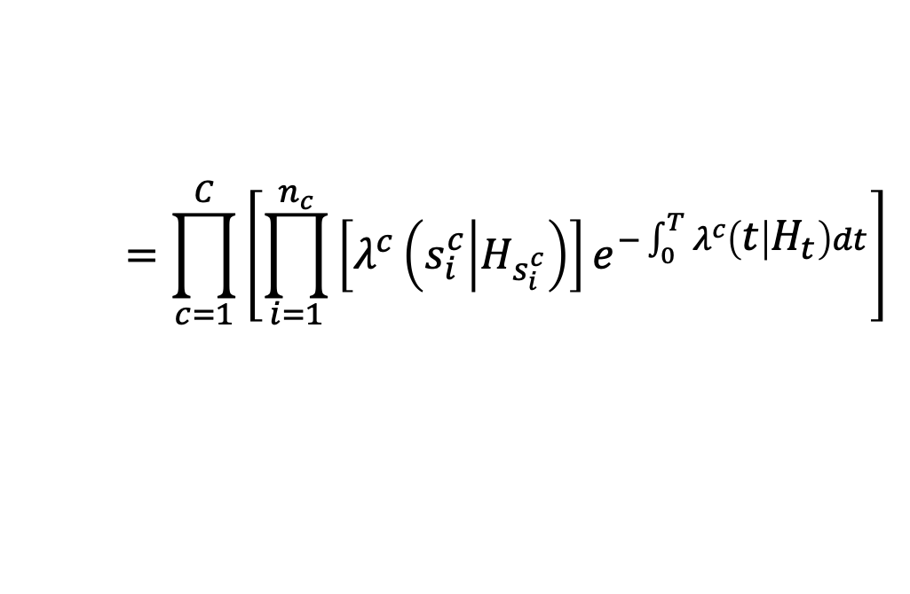
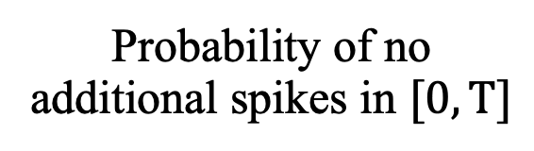
Multivariate point process likelihood
Likelihood of any spike sequence
$$ρ\left(s_{1}^{1},…,s_{n_{1}}^{1},…,s_{n_{C}}^{C},N^{1}\left(T\right)=n_{1},…,N^{C}\left(T\right)=n_{c}\right)$$
$$=\prod_{c=1}^{C}{\left[\prod_{i=1}^{n_{c}}{\left[λ^{c}\left(s_{i}^{c} | H_{s_{i}^{c}}\right)\right]e^{−\int_{0}^{T}{λ^{c}\left(t | H_{t}\right)dt}}}\right]}$$
Likelihood of spike from neuron $c$ at time $s_{i}^{c}$
Probability of no additional spikes in $[0,T]$

Slide 16
Example: Directed connectivity in crab STG
Analysis question: Detect and estimate the structure of coordinated activity between neurons and brain areas.
Common approach: Granger causality analysis
Linear time-series models for each signal given its own past activity and that of other signals
One signal is causal of another in the Granger sense if its inclusion leads to significant improvement in prediction accuracy
Note: not the same as physical causality between signals
As with many statistical methods, researchers often learn a step-by-step recipe to perform this analysis.

Slide 17
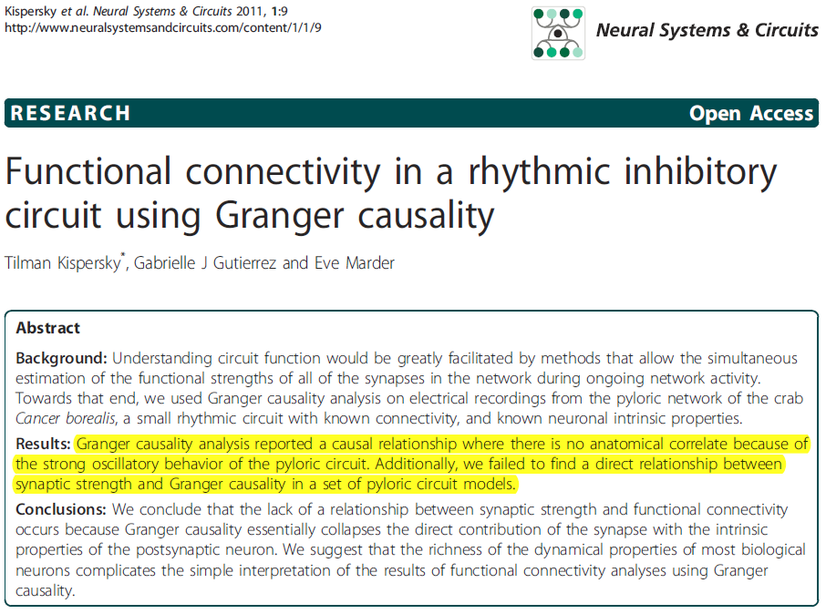
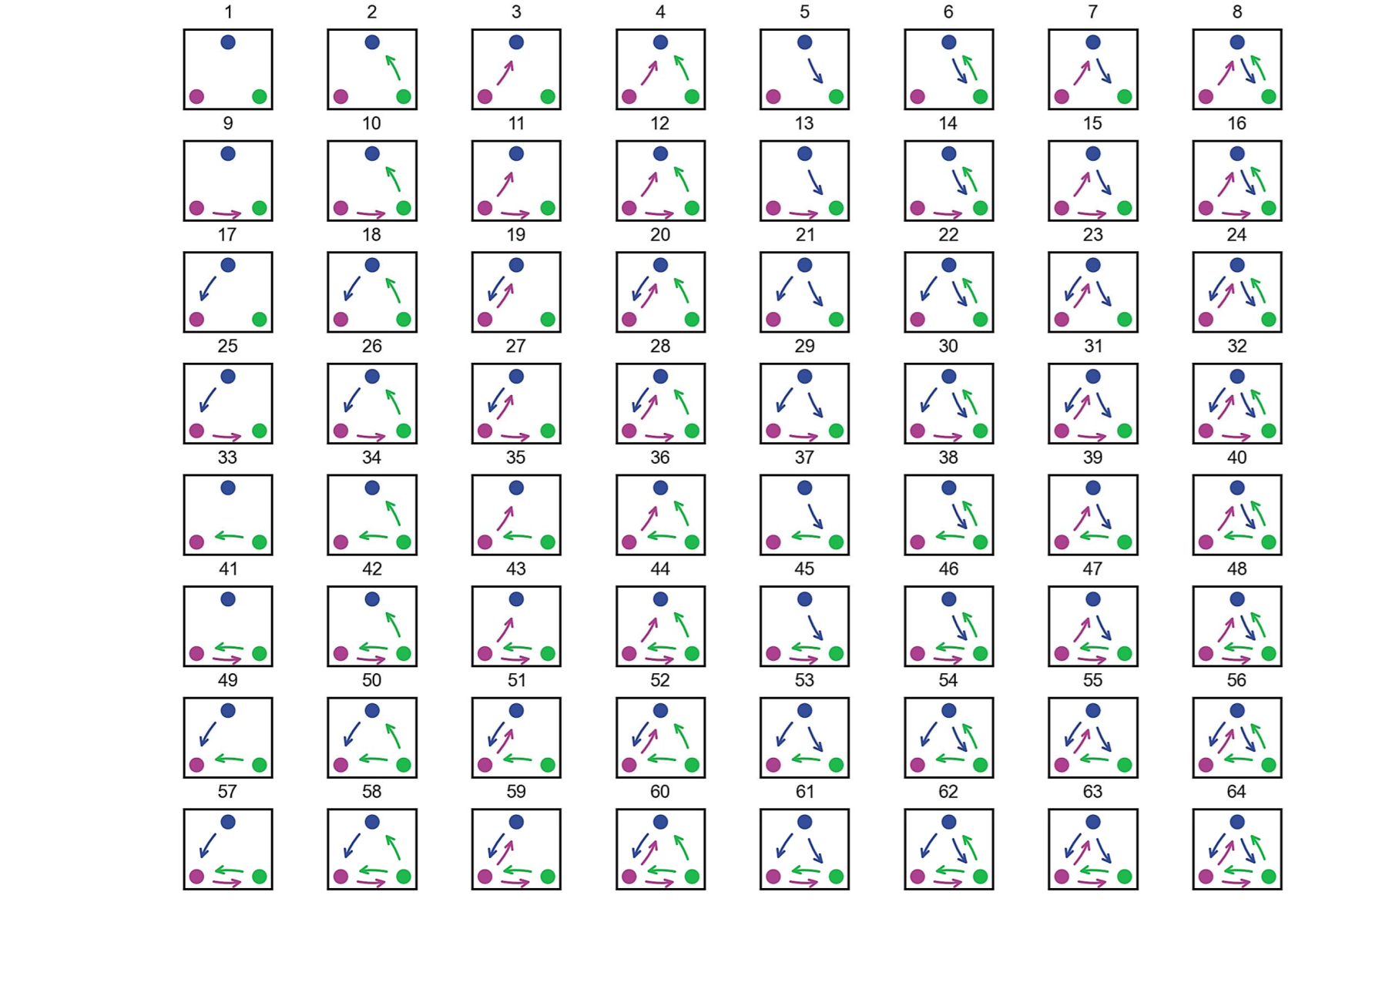
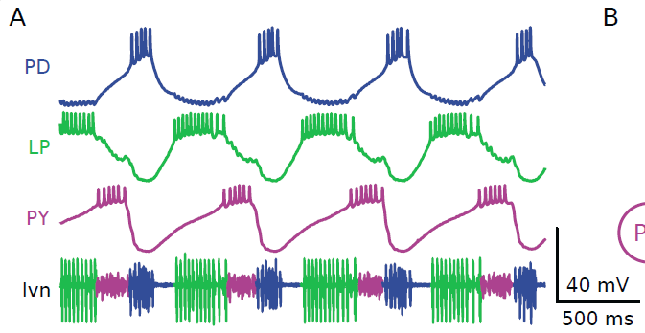
anatomy
linear Granger
Notes:
TK‘s paper

Slide 18
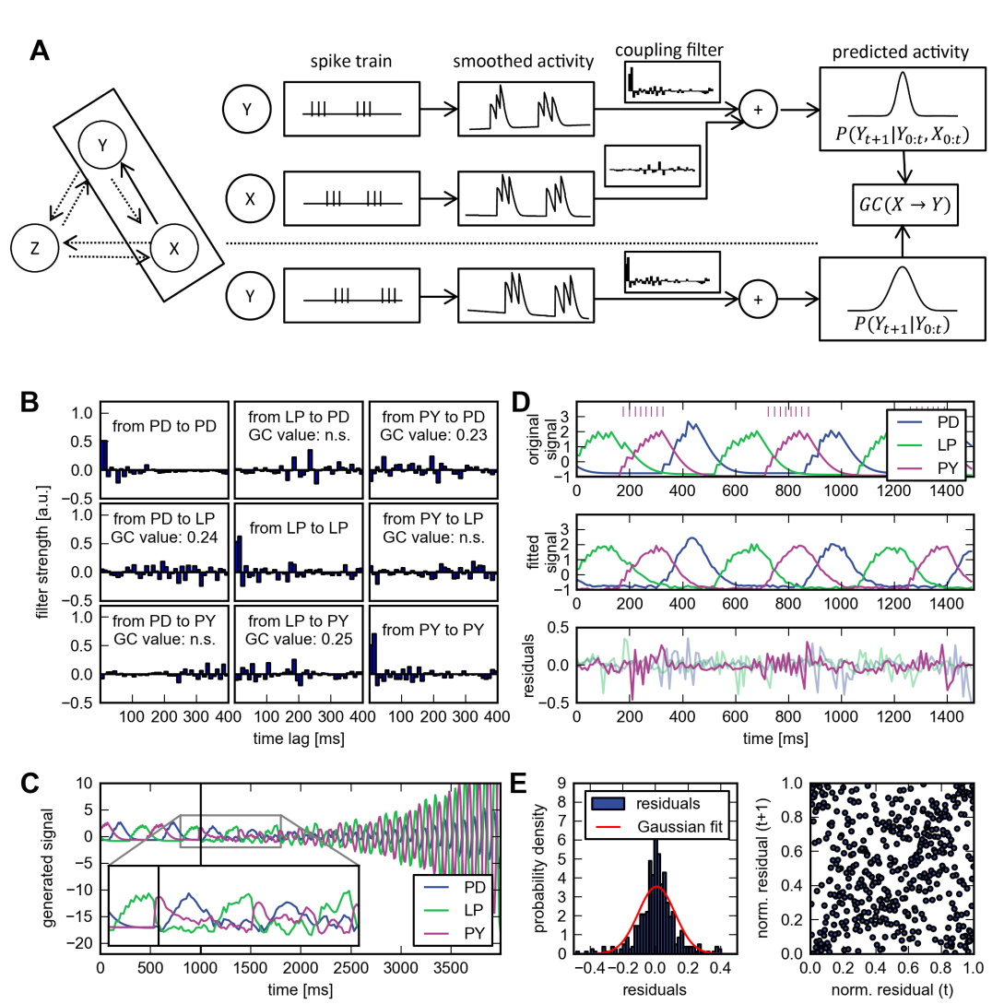
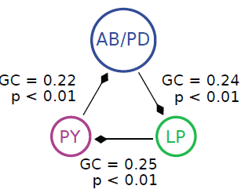
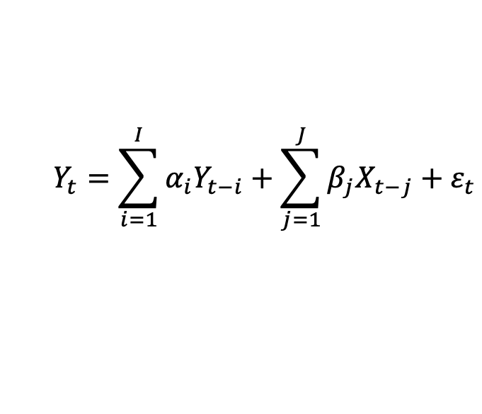
Granger causality (GC) analysis
$$Y_{t}=\sum_{i=1}^{I}{α_{i}Y_{t−i}}+\sum_{j=1}^{J}{β_{j}X_{t−j}}+ε_{t}$$
Notes:
Model-free GC?

Slide 19
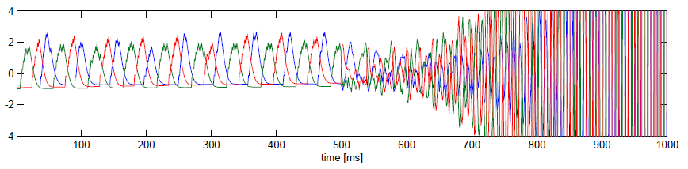
Model interpretation and assessment
A statistical model is not a black box. Opportunities to understand and evaluate model components are often missed.
Example 1: GC coupling parameters don’t reflect synaptic influences.
0
400
Lag (ms)
400
400
Example 2: GC model doesn’t reproduce rhythm on it’s own.

Slide 20
Model refinement
Use point process model to describe spike trains
Use nonlinear and multivariate model
Use physiological significance along with statistical significance
Notes:
Model-free GC?

Slide 21
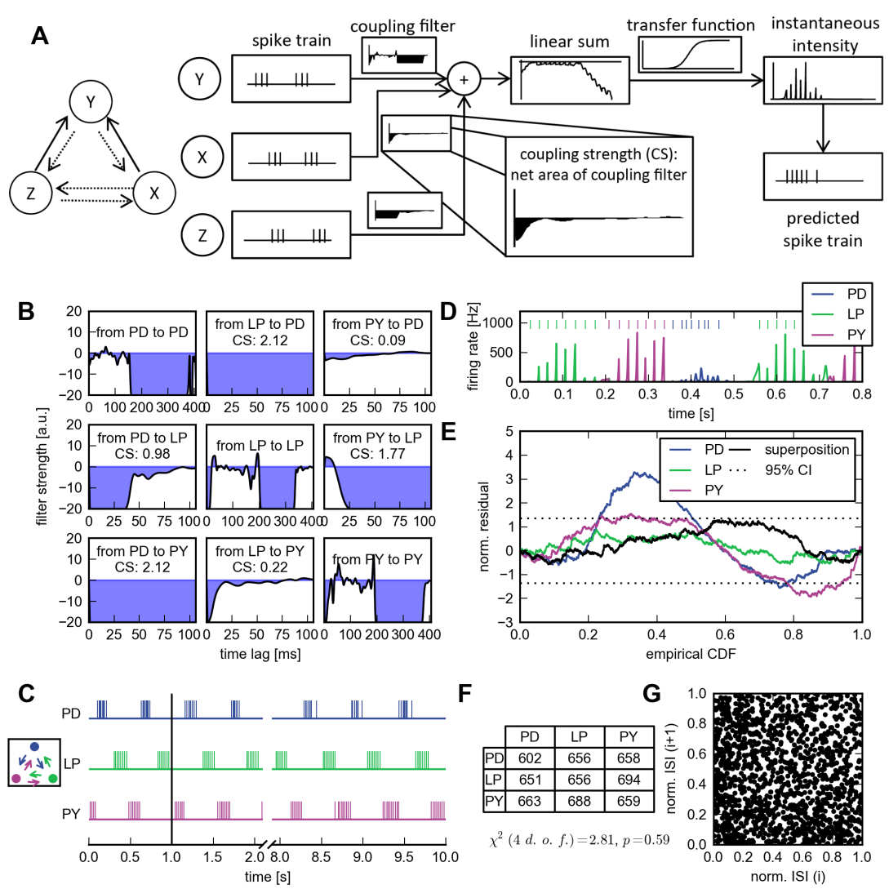
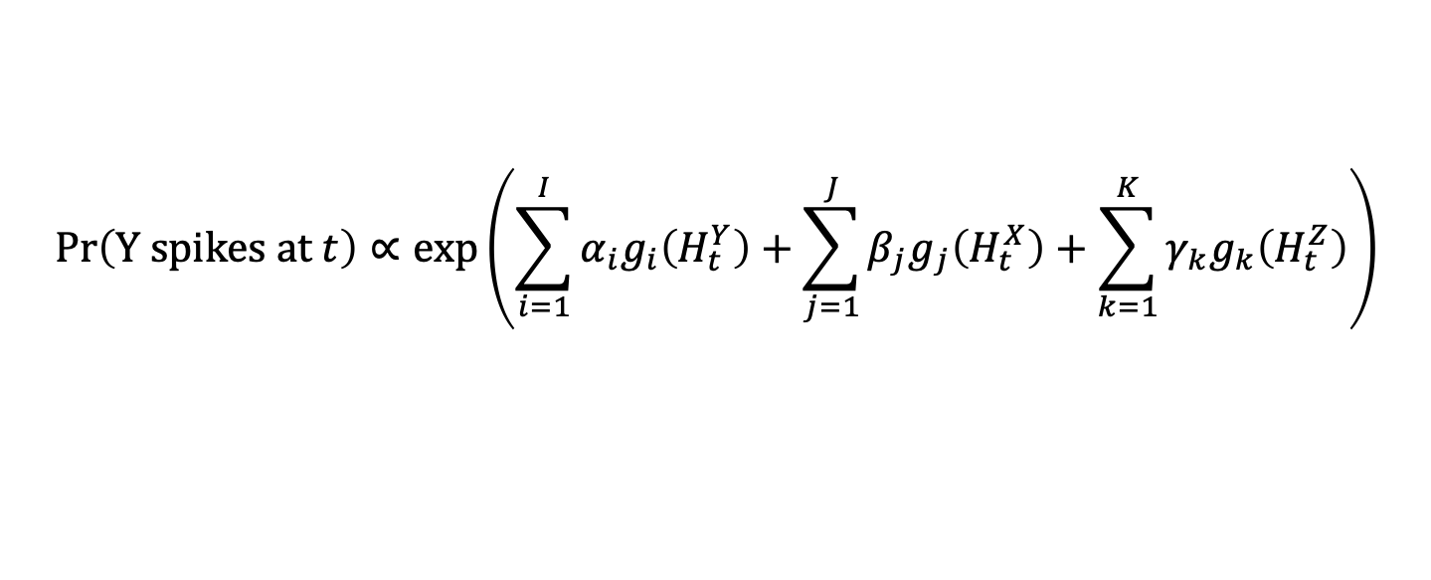
Point process analysis
$$\text{Pr}\left(\text{Y} \text{spikes} \text{at} t\right)∝\text{exp}\left(\sum_{i=1}^{I}{α_{i}g_{i}\left(H_{t}^{Y}\right)}+\sum_{j=1}^{J}{β_{j}g_{j}\left(H_{t}^{X}\right)}+\sum_{k=1}^{K}{γ_{k}g_{k}\left(H_{t}^{Z}\right)}\right)$$

Slide 22
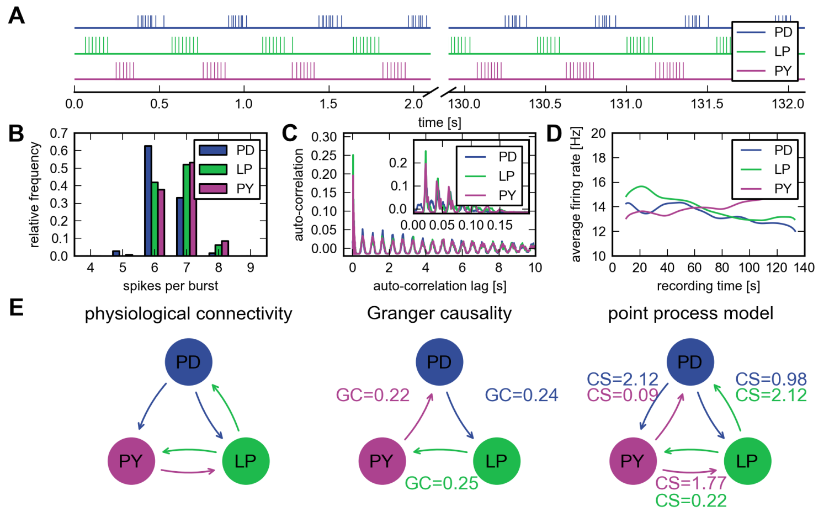
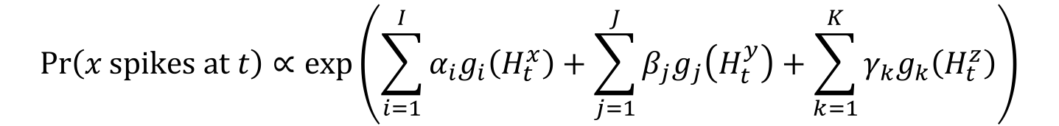
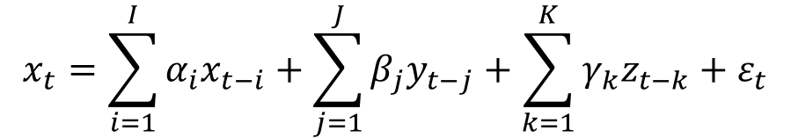
A case study on point process modeling Estimating functional connectivity in crab STG
$$x_{t}=\sum_{i=1}^{I}{α_{i}x_{t−i}}+\sum_{j=1}^{J}{β_{j}y_{t−j}}+\sum_{k=1}^{K}{γ_{k}z_{t−k}}+ε_{t}$$
$$\text{Pr}\left(x \text{spikes} \text{at} t\right)∝\text{exp}\left(\sum_{i=1}^{I}{α_{i}g_{i}\left(H_{t}^{x}\right)}+\sum_{j=1}^{J}{β_{j}g_{j}\left(H_{t}^{y}\right)}+\sum_{k=1}^{K}{γ_{k}g_{k}\left(H_{t}^{z}\right)}\right)$$
(Kisperskey et al., 2011)
(Gerhard et al., 2013)

Slide 23
Point process model reproduces rhythm
$$\text{Pr}\left(x \text{spikes} \text{at} t\right)∝\text{exp}\left(\sum_{i=1}^{I}{α_{i}g_{i}\left(H_{t}^{x}\right)}+\sum_{j=1}^{J}{β_{j}g_{j}\left(H_{t}^{y}\right)}+\sum_{k=1}^{K}{γ_{k}g_{k}\left(H_{t}^{z}\right)}\right)$$
(Gerhard et al., 2013)

Slide 24
Lessons from this case study
Importance of using methods that reflect statistical structure of data.
“All models are wrong, but some are useful” – George E. P. Box
Powerful goodness-of-fit methods exist to characterize model quality – but are used infrequently.
Inference methods should be based on interpretable statistics and model parameters.

Slide 25
Spike sorting issues
In many experiments, spikes sorting cannot be performed with complete confidence
Uncertainty is sorting is rarely explicitly expressed
Propagation of sorting uncertainty to coding models is rarely explored
Sorting uncertainty leads to both bias and unmodeled variability in models
Data that cannot be easily clustered is often thrown away
Computational challenge of spike sorting precludes real-time methods (e.g. closed-loop experiments)

Slide 26
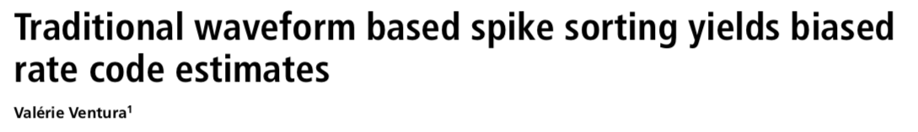
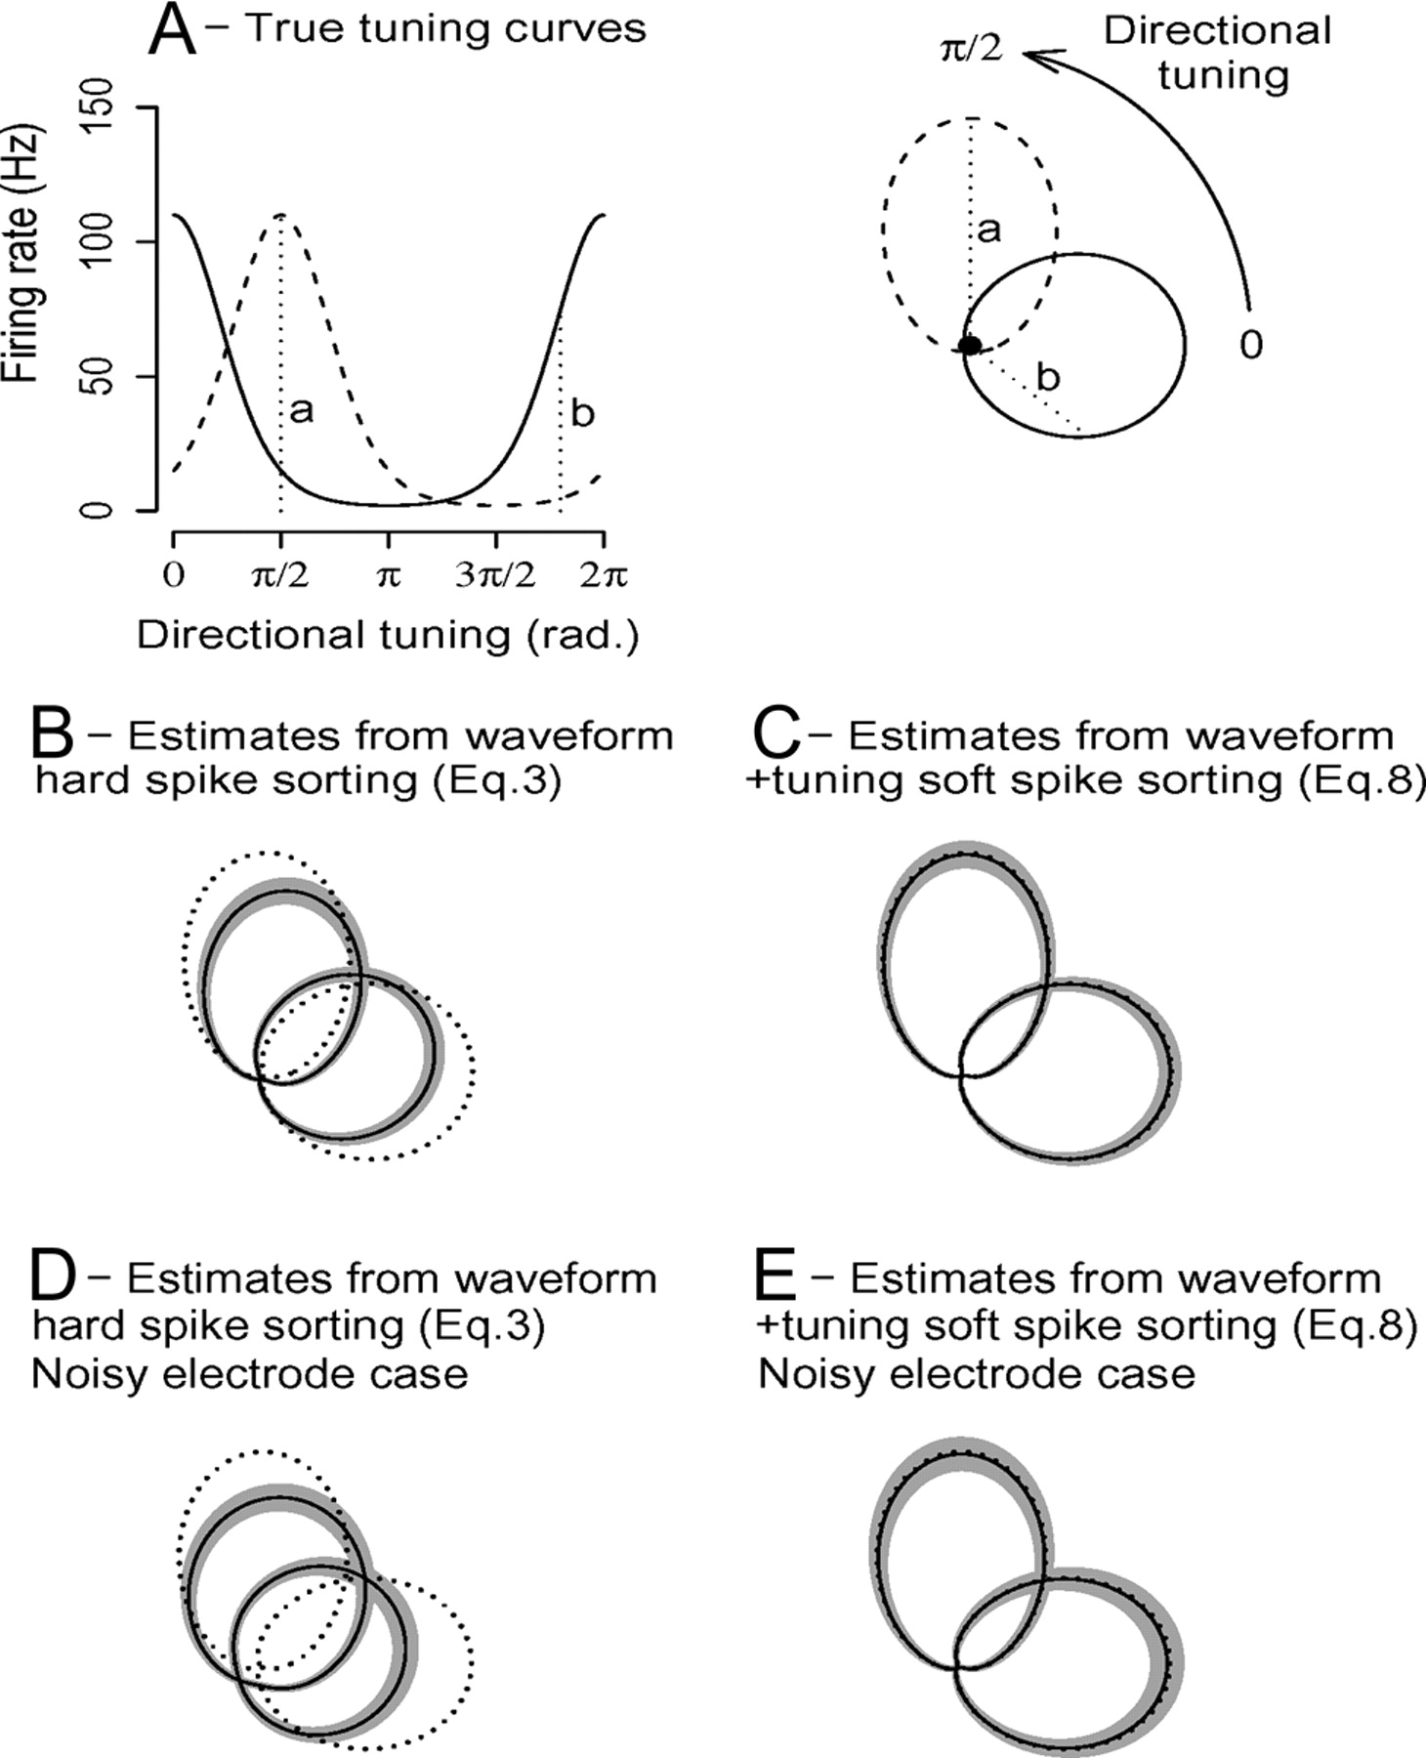
The standard two-step process of first sorting and then fitting tuning curves leads to biased estimates.
This, despite the primary motivation cited for a separate sorting step being to prevent a form of bias.
One alternate approach: soft sorting
Modeling goals?

Slide 27

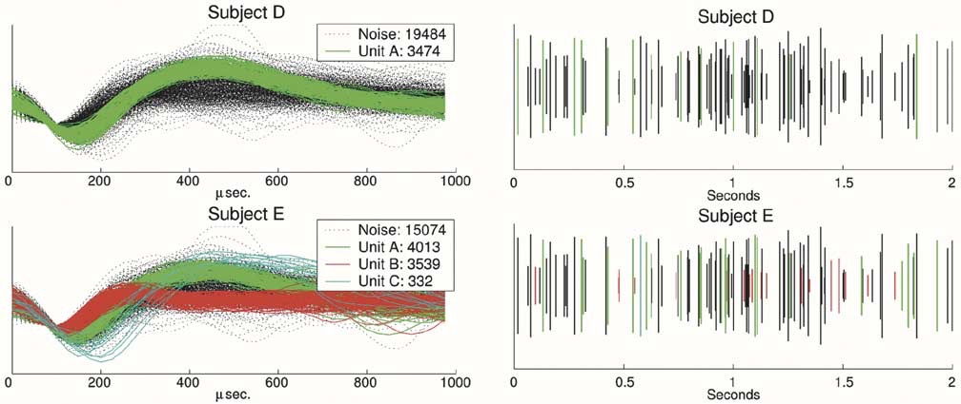
Comparisons between trained spike sorters from same lab showed extreme variability in the number of units identified, spikes sorted, and identity assignments.
In some cases, sorting disregards >80% of threshold crossings

Slide 28
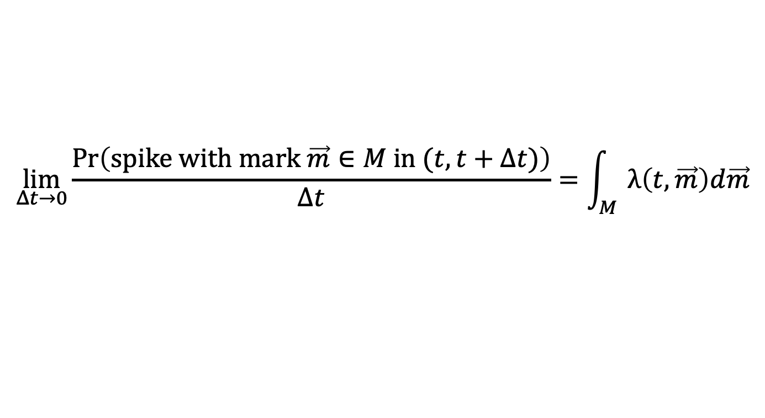
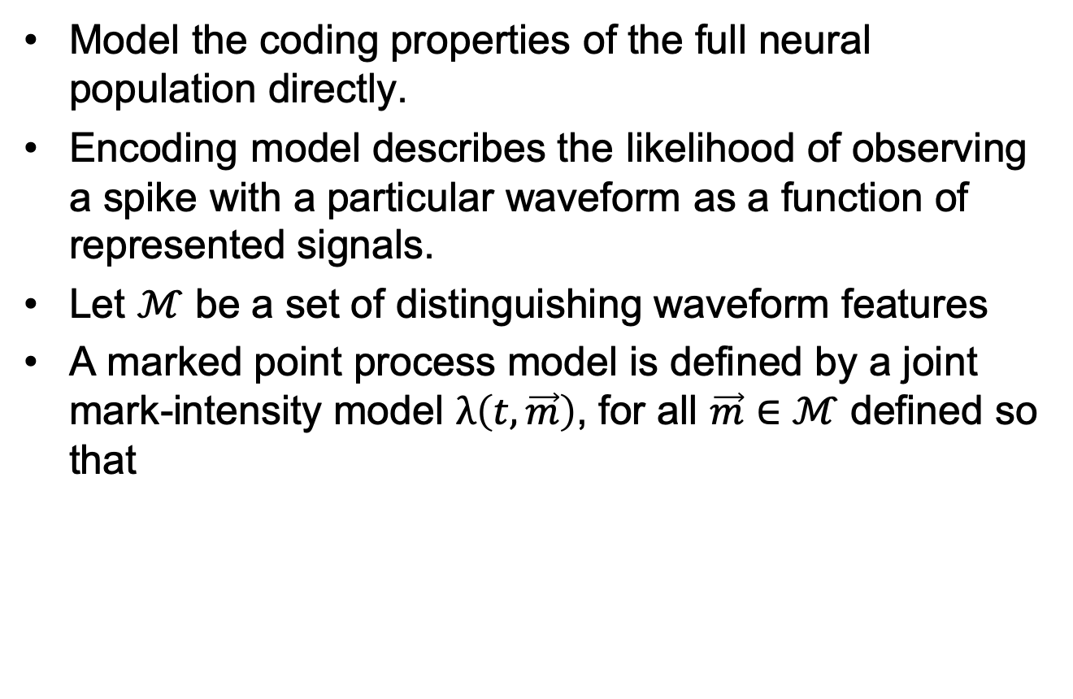
An alternative approach
Model the coding properties of the full neural population directly.
Encoding model describes the likelihood of observing a spike with a particular waveform as a function of represented signals.
Let $ℳ$ be a set of distinguishing waveform features
A marked point process model is defined by a joint mark-intensity model $λ\left(t,\vec{m}\right)$, for all $\vec{m}∈ℳ$ defined so that
$$\lim_{Δt→0}{\frac{\operatorname{Pr}\left(spike with mark \vec{m}∈M in (t,t+Δt)\right)}{Δt}}=\int_{M}{λ\left(t,\vec{m}\right)d\vec{m}}$$

Slide 29
Marked point process models
Encoding model with sorted spikes:
$$\left.{\hat{Λ}}^{c}(x(t)\right)$$
Marked point process encoding model:
$$\left.\hat{λ}(x\left(t\right),m\right)$$

Slide 30
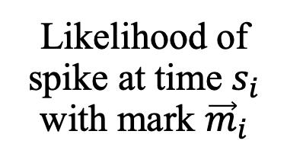
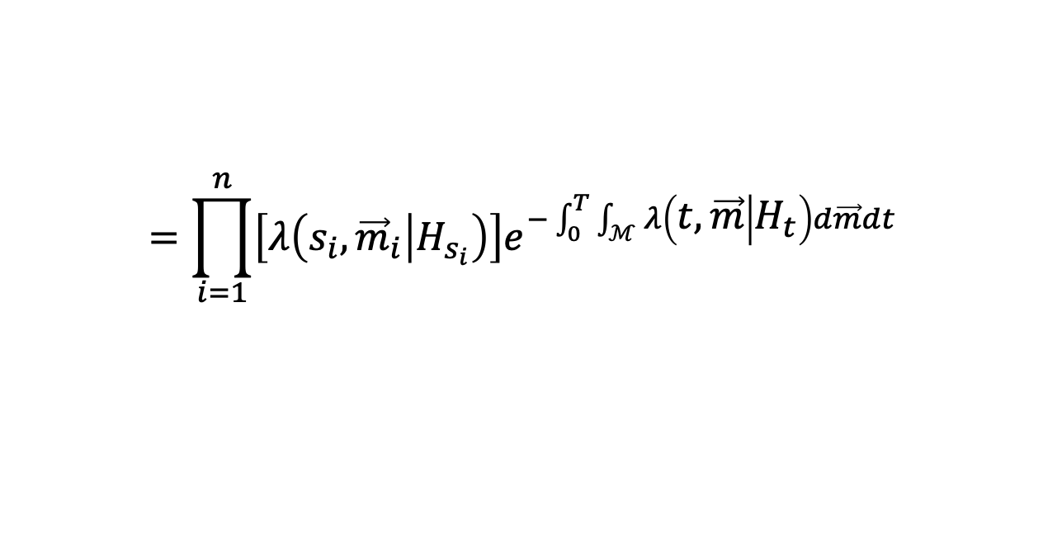
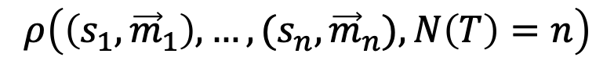
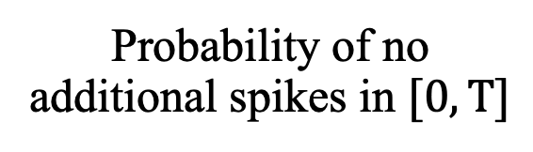
Marked point process models
Likelihood of any spike sequence
$$ρ\left(\left(s_{1},{\vec{m}}_{1}\right),…,{(s}_{n},{\vec{m}}_{n}),N\left(T\right)=n\right)$$
$$=\prod_{i=1}^{n}{\left[λ\left(s_{i},{\vec{m}}_{i} | H_{s_{i}}\right)\right]e^{−\int_{0}^{T}{\int_{ℳ}{λ\left(t,\vec{m} | H_{t}\right)d\vec{m}}dt}}}$$
Likelihood of spike at time $s_{i}$ with mark ${\vec{m}}_{i}$
Probability of no additional spikes in $[0,T]$

Slide 31
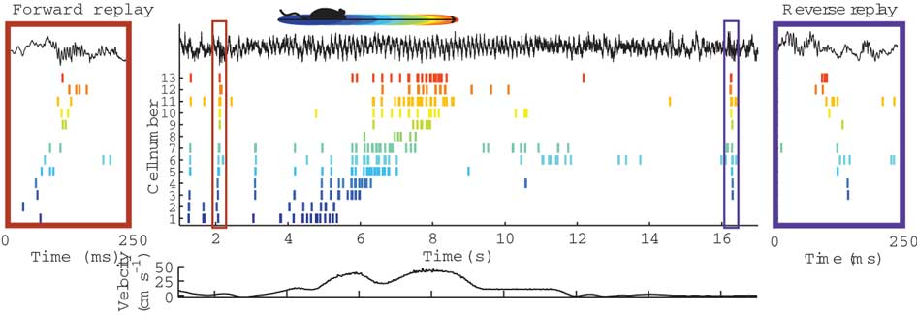
A motivating problem: Awake Hippocampal Replay
Reoccurrence of sequences of neural activation that also occurred during activity, at a faster time scale
Important for memory consolidation and learning of navigation tasks
Carr et al., 2011.

Slide 32
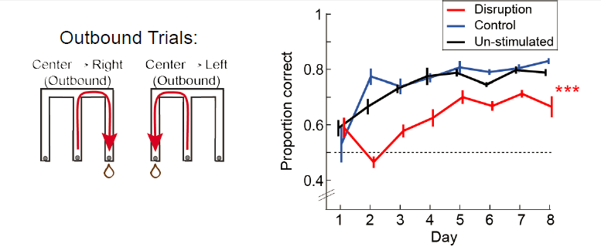
Experimental Challenge
Interrupting all replay events leads to substantial deficits in navigational learning tasks.
Ultimate goal: Decode replay content in real time to selectively interrupt events.
Preliminary goal: Decode movement in real time without spike sorting
Jadhav et al., 2012

Slide 33
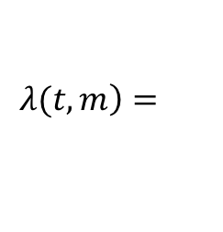

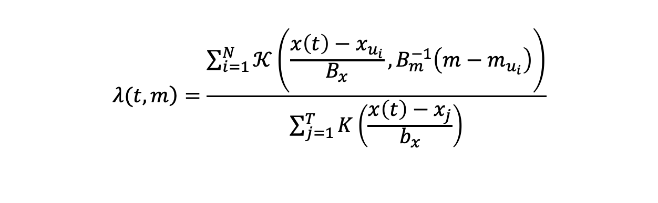
Marked point process models
$$\lim_{∆t→0}{{∆t}^{−1}}\operatorname{Pr}\left[\left.\text{spike} \text{with} \text{mark} \text{in} ℳ in\text{ [}t,t+∆t\right)\right]=\int_{ℳ}{\left.λ(t,m\right)}dm$$
Nonparametric:
$$\left.λ(t,m\right)=\frac{\sum_{i=1}^{N}{𝒦\left(\frac{x\left(t\right)−x_{u_{i}}}{B_{x}},B_{m}^{−1}\left(m−m_{u_{i}}\right)\right)}}{\sum_{j=1}^{T}{K\left(\frac{x\left(t\right)−x_{j}}{b_{x}}\right)}}$$
Semiparametric:
$$\left.λ(t,m\right)=$$
$$\sum_{c=1}^{C}{w_{c}𝒦\left(\frac{x\left(t\right)−μ_{x,c}}{Σ_{x,c}},Σ_{m}^{−1}\left(m−μ_{m,c}\right)\right)}$$

Slide 34
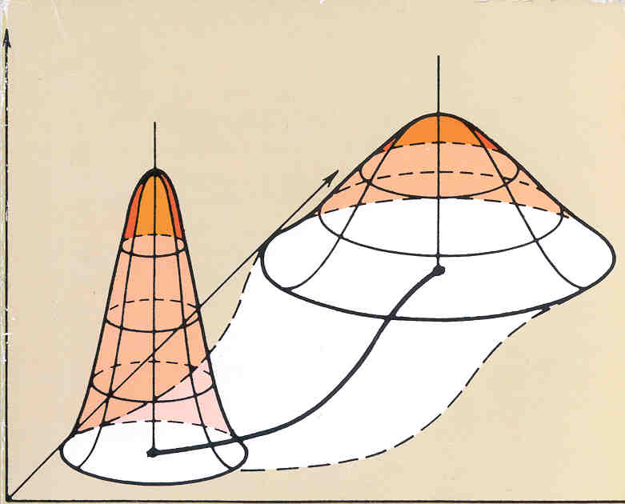
State Estimation
Neural intensity model characterizes p(spikes|state)
For state estimation, we must track p(state|spikes).
Get estimators
Higher order statistics
Application of Bayes’ rule

Slide 35
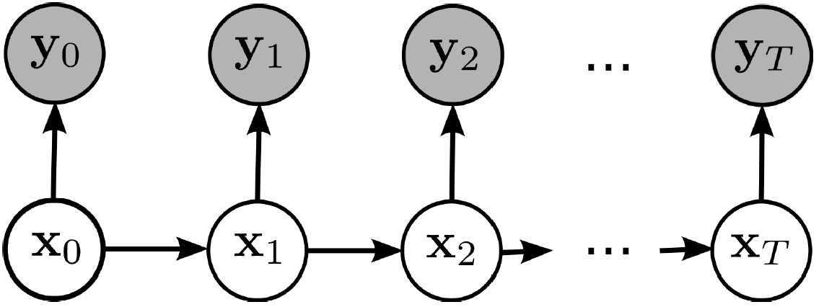
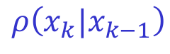
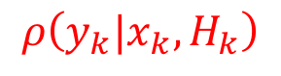
The state-space paradigm
An unobserved state process (x_{t}) undergoes stochastic dynamics that influence a set of observation processes (y_{t})
Classically, the states represent directly observable features of a behavioral task
E.g. Decoding location from ensemble spiking in rat hippocampus
Recently, states have been used to represent unobserved, low-dimensional dynamics of neural representations
$$ρ\left(y_{k}|x_{k},H_{k}\right)$$
$$ρ\left(x_{k}|x_{k−1}\right)$$

Slide 36
Decoding filter
State model:
$$ρ\left(x_{k}|x_{k−1}\right)$$
Observation model:
$$ρ\left({ΔN}_{k}, {\left\{m_{k_{i}}\right\}}_{i=1}^{{ΔN}_{k}}|x_{k},H_{k}\right)=\prod_{i=1}^{{ΔN}_{k}}{\left[λ\left(t_{k},m_{k_{i}}\right)\right]e^{−Δt\int_{ℳ}{λ\left(t_{k},m \right)dm}}}$$
Bayes’ rule:
$$ρ\left(x_{k}|{ΔN}_{k}, {\left\{m_{k_{i}}\right\}}_{i=1}^{{ΔN}_{k}},H_{k}\right)∝ρ\left({ΔN}_{k}, {\left\{m_{k_{i}}\right\}}_{i=1}^{{ΔN}_{k}}|x_{k},H_{k}\right)ρ\left(x_{k}|H_{k}\right)$$
Chapman-Kolmogorov equation:
$$ρ\left(x_{k}|H_{k}\right)=\int{ρ\left(x_{k}|x_{k−1}\right)ρ\left(x_{k−1}|{ΔN}_{k−1}, {\left\{m_{{k−1}_{i}}\right\}}_{i=1}^{{ΔN}_{k−1}},H_{k−1}\right)}dx_{k−1}$$
Iterative equation for posterior density:
$$ρ\left(x_{k}|{ΔN}_{k}, {\left\{m_{k_{i}}\right\}}_{i=1}^{{ΔN}_{k}},H_{k}\right)∝$$
$$ρ\left({ΔN}_{k}, {\left\{m_{k_{i}}\right\}}_{i=1}^{{ΔN}_{k}}|x_{k},H_{k}\right)\int{ρ\left(x_{k}|x_{k−1}\right)ρ\left(x_{k−1}|{ΔN}_{k−1}, {\left\{m_{{k−1}_{i}}\right\}}_{i=1}^{{ΔN}_{k−1}},H_{k−1}\right)}dx_{k−1}$$

Slide 37
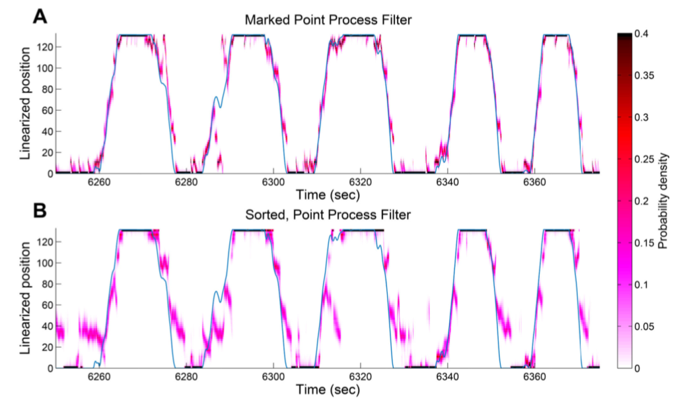
Decoding – model comparison
Surprisingly, clusterless decoding trajectories were more certain and more accurate

Slide 38
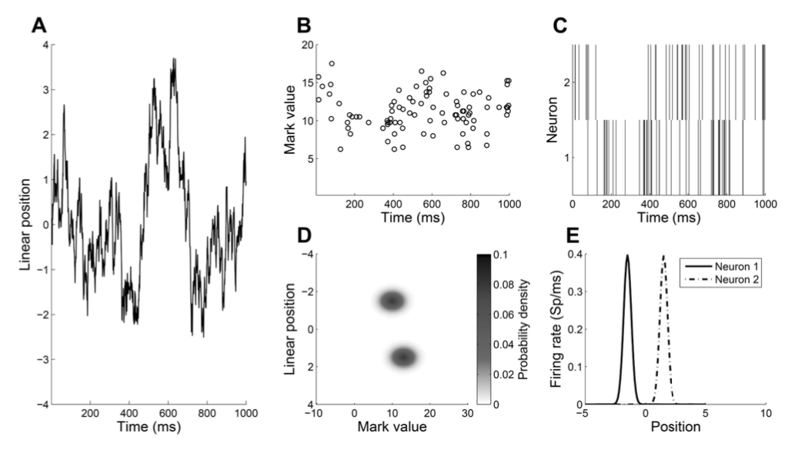
Improvement in decoding
Simple simulation involving two neurons with overlapping waveform features

Slide 39
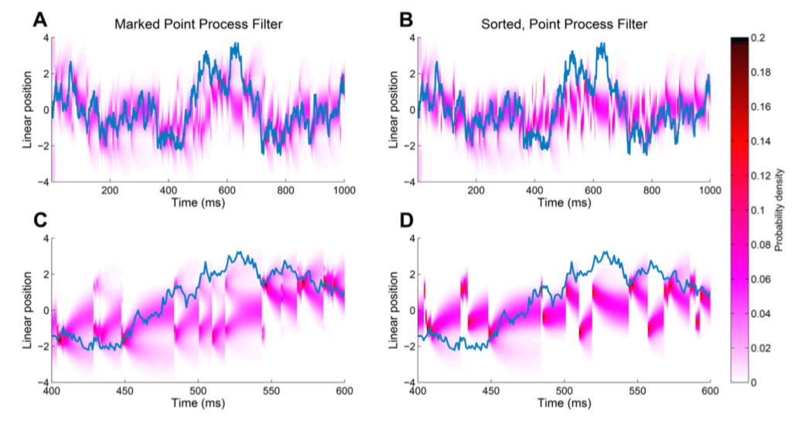
Improvement in decoding
Simple simulation involving two neurons with overlapping waveform features

Slide 40
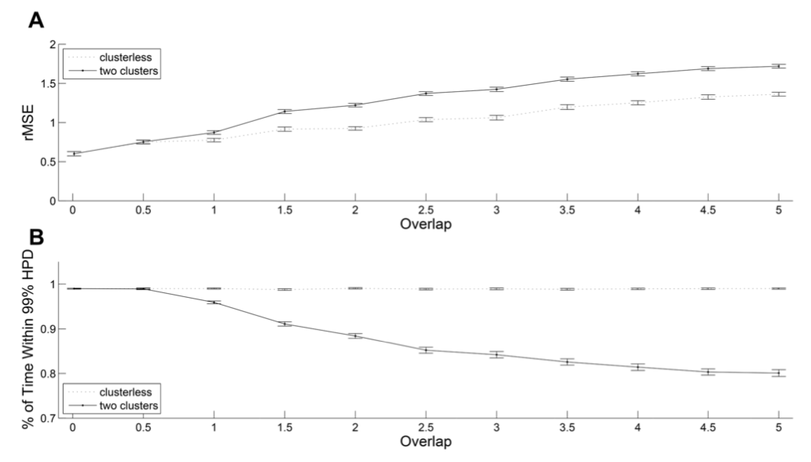
Improvement in decoding
Simple simulation involving two neurons with overlapping waveform features

Slide 41
Clusterless decoding conclusions
Marked point processes produce real-time decoding algorithms suitable for closed-loop experiments
Clusterless models eliminate bias imposed by two step (sorting, model fitting) process
Clusterless models allow us to retain unclassifiable spikes that provide coding information
Clusterless decoding provides a natural measure for assessing the quality of population-level coding models.

Slide 42


Back to motivating example (if there’s time)
Challenge:
Replay relates to a process of reactivation that is not directly observable.
Approach – State-space estimation:
Discrete and continuous latent processes that drive observations are estimated using a filter/smoother + EM algorithm.
$$ρ\left(y_{k}|x_{k},I_{k},H_{k}\right)$$
$$ρ\left(x_{k}|x_{k−1},I_{k},I_{k−1}\right)$$
I₀
I₁
I₂
I_{T}

Slide 43





Decoding discrete replay features
Initial condition:
$$ρ\left({I,x}_{0}\right)=ρ\left(x_{0}|I\right)ρ\left(I\right)$$
State model:
$$ρ\left(x_{k}|x_{k−1},I\right)$$
Observation model:
$$ρ\left({ΔN}_{k}, {\left\{m_{k_{i}}\right\}}_{i=1}^{{ΔN}_{k}}|I,x_{k},H_{k}\right)$$
Discrete state, marked point process filter:
$$\operatorname{Pr}\left(I|H_{k+1}\right)∝\int{ρ\left(I,x_{k}|{ΔN}_{k}, {\left\{m_{k_{i}}\right\}}_{i=1}^{{ΔN}_{k}},H_{k}\right)dx_{k}}∝$$
$$\int{ρ\left({ΔN}_{k}, {\left\{m_{k_{i}}\right\}}_{i=1}^{{ΔN}_{k}}|I,x_{k},H_{k}\right)\int{ρ\left(x_{k}|x_{k−1},I\right)ρ\left(I,x_{k−1}|H_{k}\right)dx_{k−1}}dx_{k}}$$

Slide 44






Real time decoding of discrete replay features
Replay 1
Replay 2

Slide 45
Toward closed-loop interruption
At a 0.8 confidence level, nearly all replay events can be classified within first 100 ms.

Slide 46
Applications of state space neural models
Estimating ionic currents in dynamical neural models
Identifying changing spiking patterns in Parkinson’s disease
Controlling neural motor prosthetic devices
Tracking changing neural representations related to plasticity and learning
Identifying switches between local representations of space and nonlocal representations.
Transitions between tonic and bursting spiking regimes
Identifying low dimensional manifolds of neural coactivation
Selecting neurons that code for internal representations of value
Real-time phase estimation for neural rhythms
Joint decoding from spiking and LFP rhythms.

Slide 47
Conclusions
Point process models can provide insight into how neural systems coordinate spiking activity to represent and process information.
Marked point processes theory allows us to construct models of population coding, assess their ability to explain structure in spiking data, and make inferences about signals driving the neurons.
Clusterless models allow for preservation of data, reduction of bias, and computationally efficient methods for online applications.

Slide 48
Acknowledgements
Xinyi Deng, BU
Long Tao, BU
Kensuke Arai, BU
Ali Yousefi, MGH
Felipe Gerhard, BU
Loren Frank, UCSF
Daniel Liu, UCSF
Kenneth Kay, UCSF
Eve Marder, Brandeis
Gabrielle Guitierrez, Brandeis
Tilman Kispersky, Brandeis
NSF IIS-0643995
NIH R01-NS073118
Simons Collaboration on the Global Brain
Notes:
48

